Slide 1

Electric Vehicle Sales by State in India

Slide 2
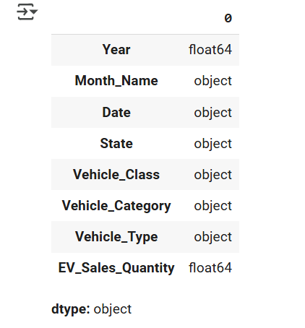
Dataset Information
Size of data : (96845, 8)
Columns Name: ['Year', 'Month_Name', 'Date', 'State', 'Vehicle_Class', 'Vehicle_Category', 'Vehicle_Type', 'EV_Sales_Quantity’]
Unique Columns: 8
Data Type of Columns:

Slide 3
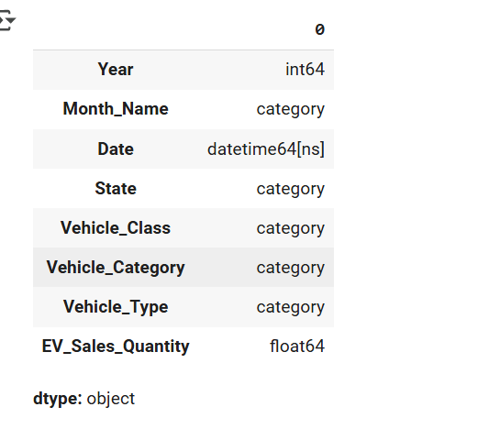
Transform the data type of features to required
‘Date’ column was Object it is converted to date using : df['Date']=pd.to_datetime(df['Date’])
‘Year’ column was Float it is converted to int using : df['Year'] =df['Year'].astype(int)

Slide 4
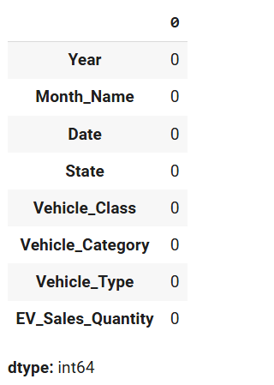
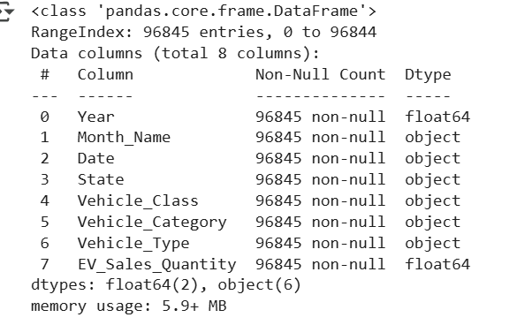
Check for missing values
There is no missing value in any features

Slide 5
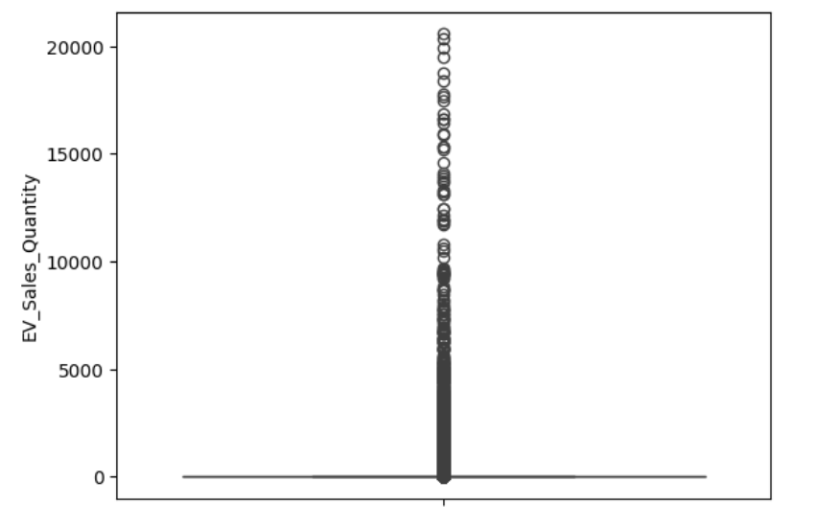
Check for Outliers in Numerical Value
Checking for Column:'EV_Sales_Quantity’ --→ There is no outliers

Slide 6
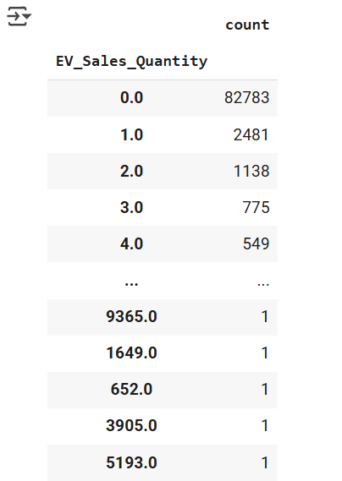
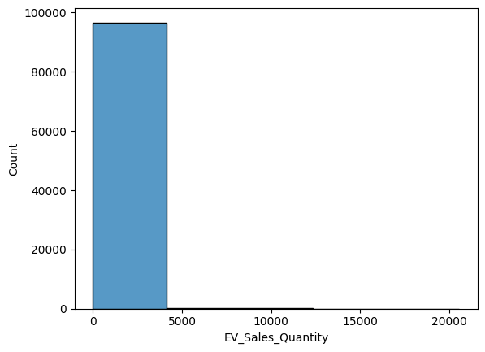
Analyzing 'EV_Sales_Quantity’ Features

Slide 7
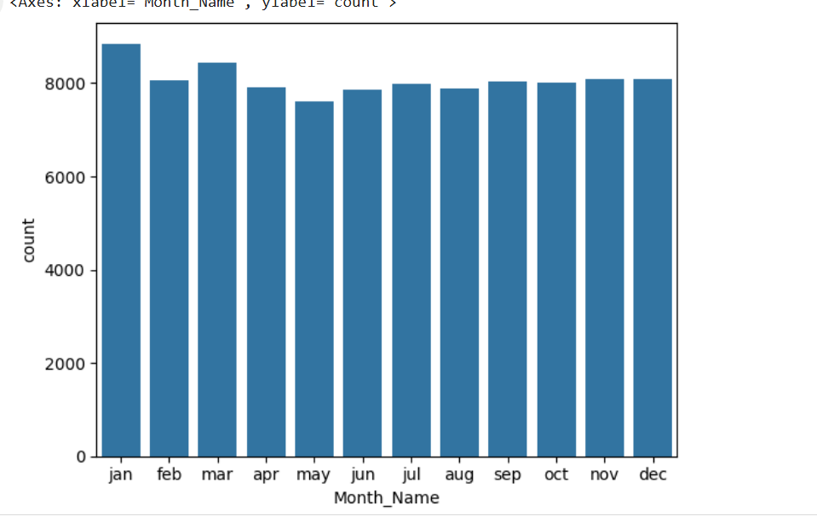
Data Visualization
In Jan month the no. of sales are large

Slide 8
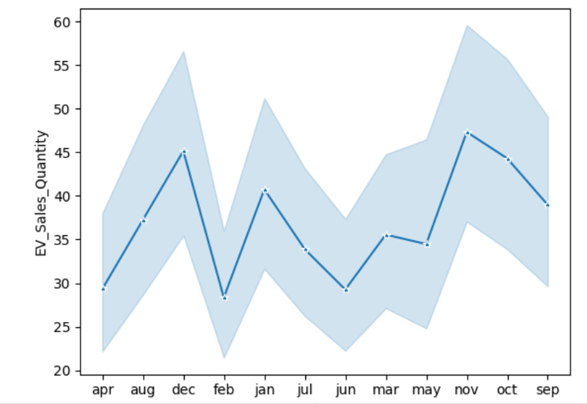
Data Visualization
Sales Quantity over month : It is highest in dec and drop in feb

Slide 9
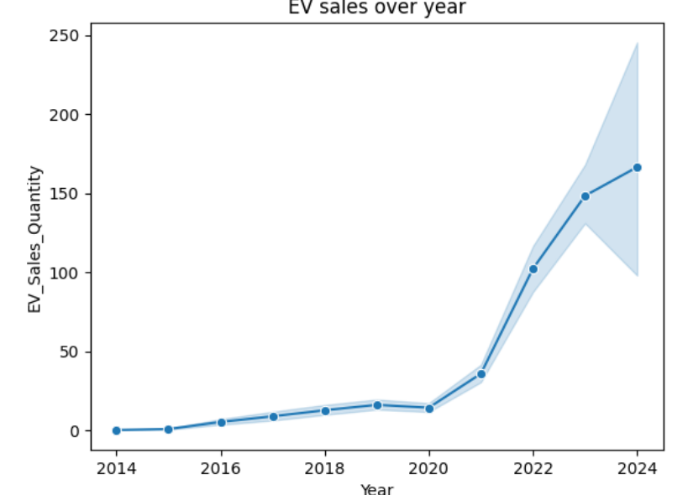
Data Visualization
Sales Quantity over year: It shows the good trend rises from 2104 to 2024 significantly

Slide 10
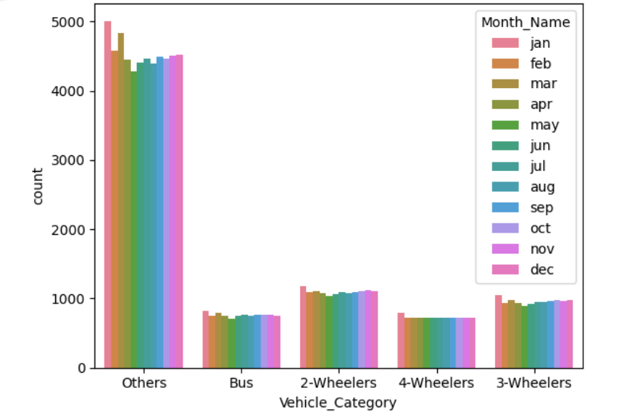
Data Visualization
Others vehicle category has the maximum number of sales and then the 2 wheelers has maximum sales

Slide 11
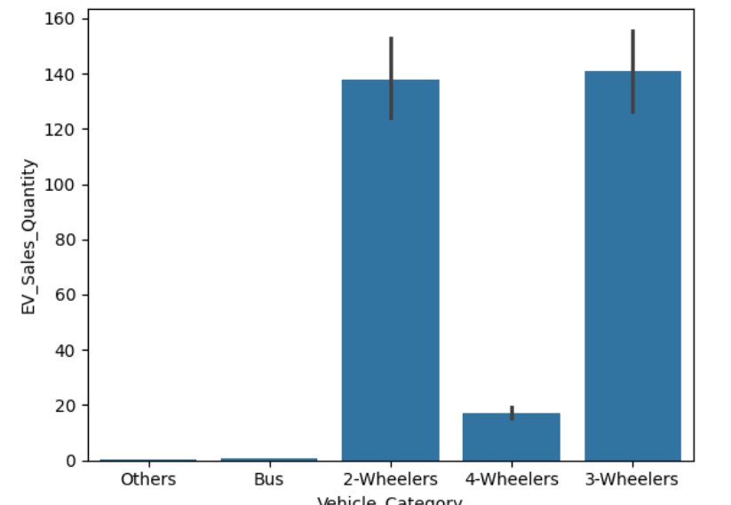
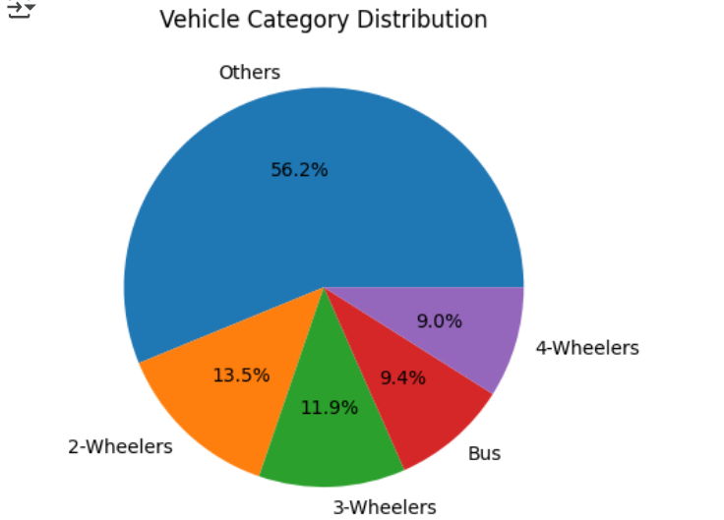
Data Visualization
2 wheelers and 3 wheelers has the maximum sales

Slide 12
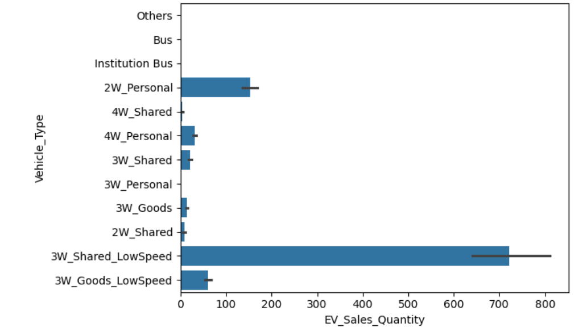
Data Visualization
3W low speed has the maximum sales

Slide 13
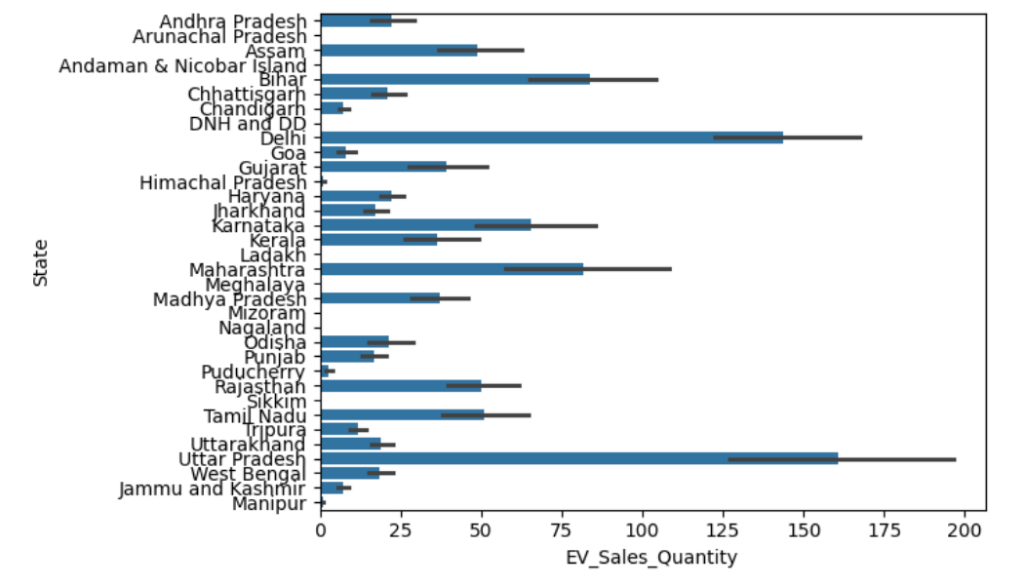
Data Visualization
UP and Delhi has the maximum sales

Slide 14
Feature Engg and One hot encoding
To extract the month details from the date column df['Month'] = df['Date'].dt.month
To extract the day details from the date column df['Day'] = df['Date'].dt.day
one hot encoding of categorical variables using ## one hot encoding of catg
cat_column =['State','Vehicle_Type','Vehicle_Category','Vehicle_Class']
df_encoded = pd.get_dummies(df, columns=cat_column, drop_first=True)

Slide 15

ML Models for Sales Prediction
Linear Regression
Logistic Regression
Random Forest Regressor
Xgboost
KNN

Slide 16
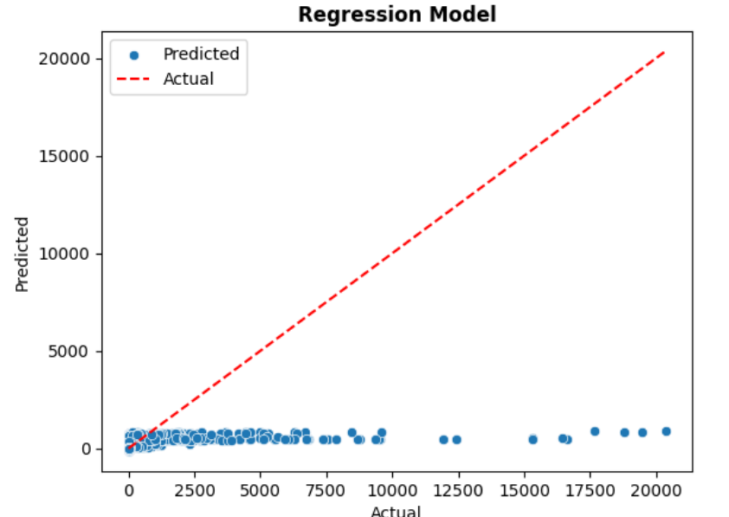
Prediction using Linear Regression
Error Metric | Value
MAE | 395427.58
R2 | 0.13
RMSE | 620092.13

Slide 17
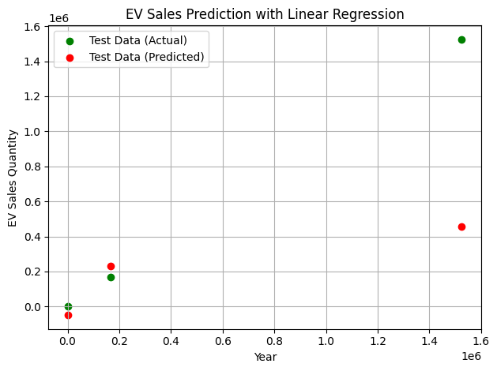
Forecasting using Linear Regression

Slide 18
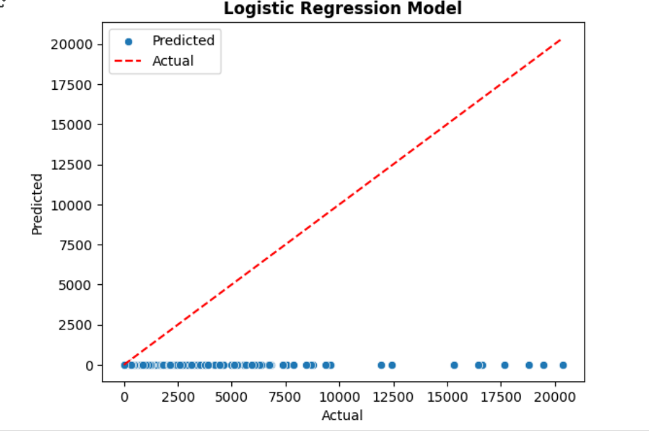
Prediction using Logisitc Regression
Error Metric | Value
MAE | 42.737
R2 | -0.00701
RMSE | 512.084

Slide 19
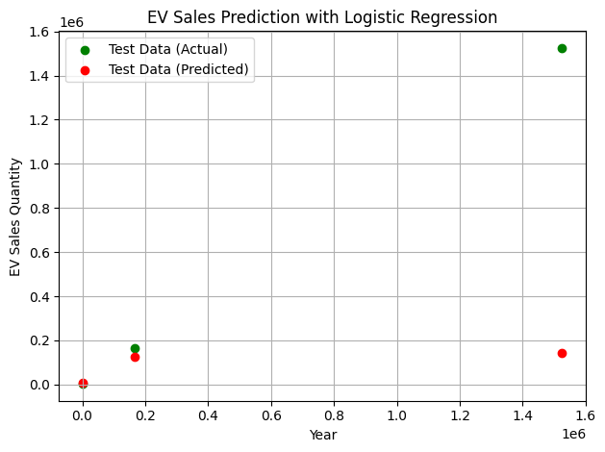
Forecasting using Logistic Regression

Slide 20
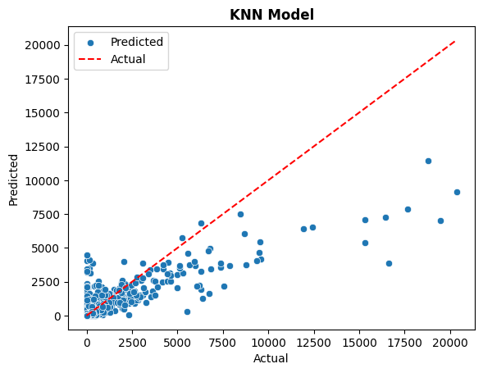
Prediction using KNN
Error Metric | Value
MAE | 294.12
R2 | 0.66
RMSE | 27.75

Slide 21
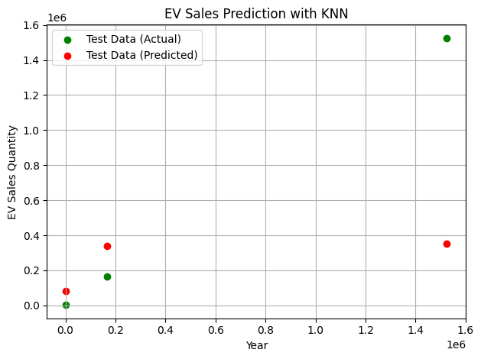
Forecasting using KNN

Slide 22
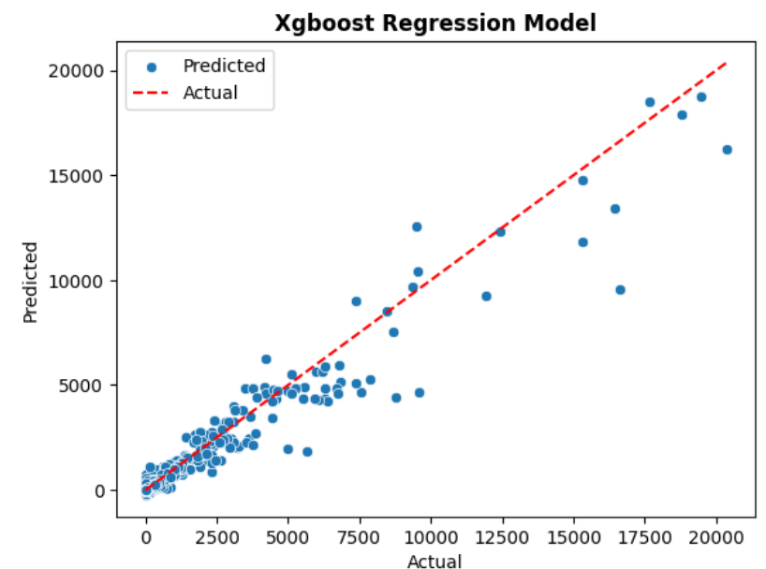
Prediction using Xgboost Regreesor
Error Metric | Value
MAE | 13.88
R2 | 0.93
RMSE | 121.84

Slide 23
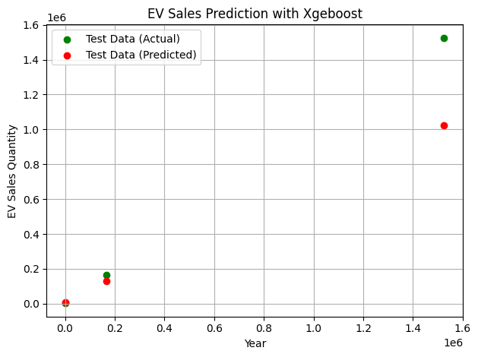
Forecasting using Xgeboost Regression

Slide 24
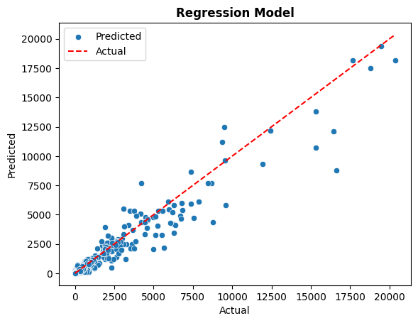
Prediction using Random Forest Regreesor
Error Metric | Value
MAE | 10.508
R2 | 0.9363
RMSE | 128.69

Slide 25
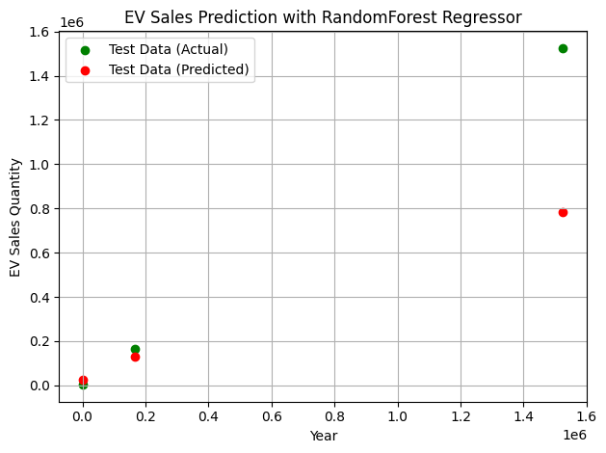
Forecasting using Random Forest Regression

Slide 26

Conclusion of Project 1
In sales prediction linear regression and logistic does not perform well.
The KNN perform better than traditional regression techniques and result in less error.
The Xgboost and Random process Regressor perform well but random process regressor reduce the error in sales forecasting.
The Xgboost models tooks very less time in training and prediction.
So, Xgboost and Random Forest Regressor can helps in sales forecasting.

